Slide 1
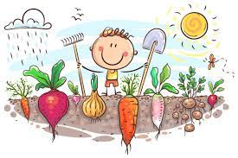
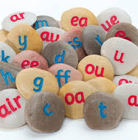
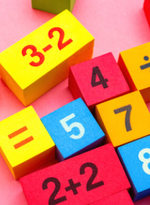
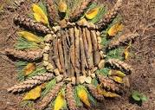
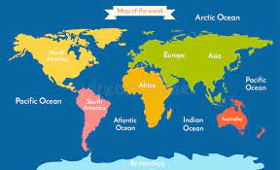
English
The children will enjoy listening to stories based on growing plants; they will listen for patterns, retell stories and predict what might happen next. They will be introduced to non fiction texts and continue to build on their writing for different purposes.
Y1 will record their ideas and start to add punctuation and adjectives to their sentences. Year 1 will be developing their writing skills through learning about plants and reading a range of fiction and non fiction texts.
Science
In science the children will be learning about how plants grow and what they need to survive. They will be investigating and experimenting and will be confident in knowing what a plant needs and they will be able to identify the key features of a plant.
Music
In music this term we will be thinking about adding music to movement. We will be exploring tempo and finding a beat.
Phonics
Reception children will be revisiting phase 3 phonics and they will be introduced to phase 4 phonics. They will be using this knowledge to support their reading and writing.
Y1 children will continue to develop their knowledge of sounds. The main focus this term will be phase 5 phonics..
How does your garden grow?
In this topic the children will learn about how to care for plants to help them grow. The children will learn the life cycle of plants and they will be able to label and name the various parts of a plant. The children will be given opportunities to plant seeds. They will carry out a science investigation to see how a plant/bean grows best. The children will also get to make their own ‘magical garden’.
Darwin Class Summer 2022
Maths
YR will be focussing numbers to 20 and beyond. They will be building numbers beyond 10. They will be adding and taking away. They will be doubling, sharing and grouping even and odd numbers.
Y1 will continue to develop their knowledge of numbers to 50 and beyond – counting, ordering, comparing, adding and subtracting and place value. They will be investigating time and money.
Computing
They will also continue to learn about safe and responsible behaviour when using the internet.
And learning how to save, reopen and edit work as well a exploring scratch junior.
PSHE/RSE
In PSHE we will discuss the importance keeping safe at home and when we are out and about.
Art & DT
In art the children will be learning about the artist Van Gogh and recreating his famous ‘Sunflowers’ painting. We will also be creating nature art using the plants and leaves around us like the artist Andy Goldsworthy.
Geography
We will be finding out about the world. Children will name and locate the world’s seven continents and five oceans. They will be looking at atlases, world maps and globes to identify the United Kingdom and its countries.
RE
In RE we will be looking at the gospels and religious stories.
PE
Skills will be learned using the ‘REAL’ PE scheme as well as playing team games in which we will discuss the importance of finding a space and how to travel around safely.
Trips
Botanical Gardens Leicester (to be confirmed)

