Slide 2
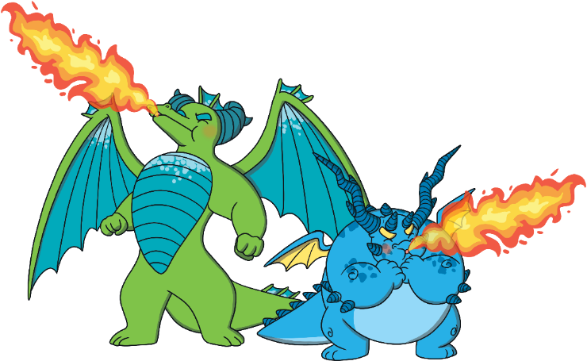
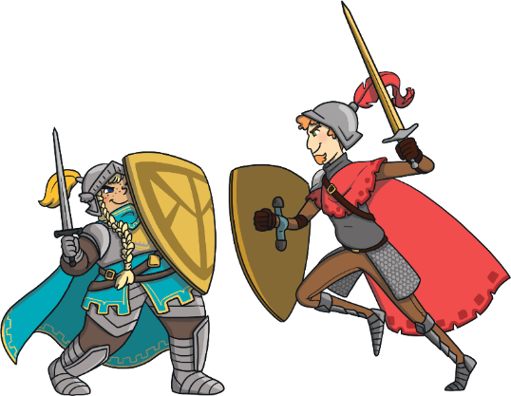
Knights and Dragons, Unite!
Read the story ‘Knights and Dragons, Unite!’ and look at the illustrations.
To see a question about the story, click this button:
?

Slide 3
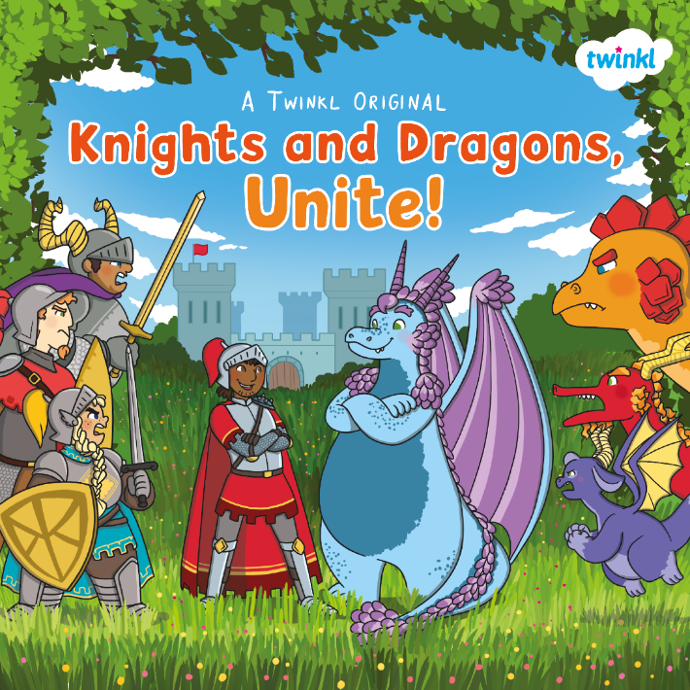
?
What do you think this story is going to be about?
?
Do you think it is fiction or non-fiction?
?
Who do you think the main characters will be?

Slide 4
?
What do you think Sir Gorrell and Aristar might try to unite the dragons and knights?
?
Why do you think Sir Gorrell and Aristar are ‘unlikely friends’?

Slide 5
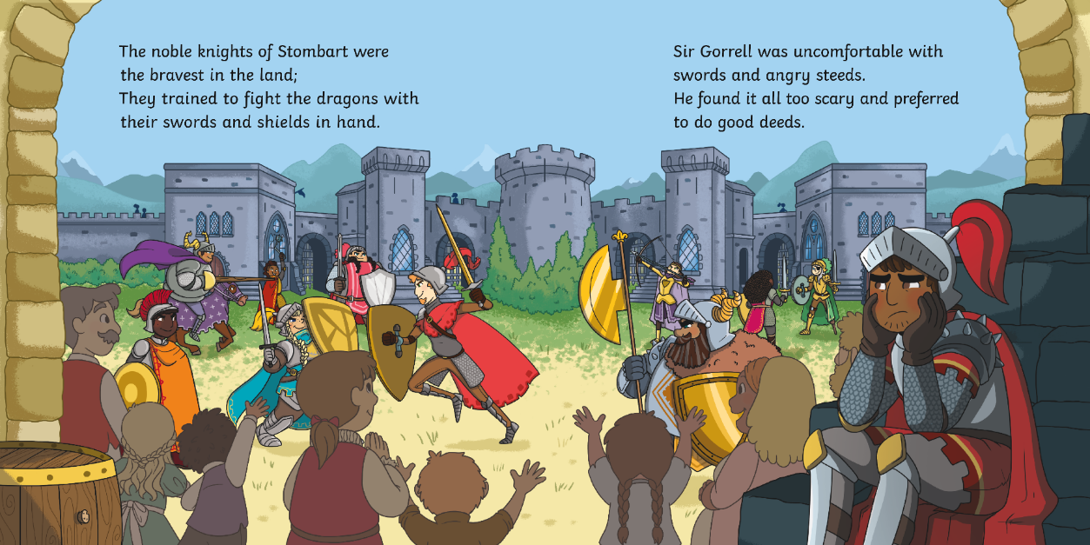
?
How do you think Sir Gorrell is feeling in this moment? What makes you think that?

Slide 6
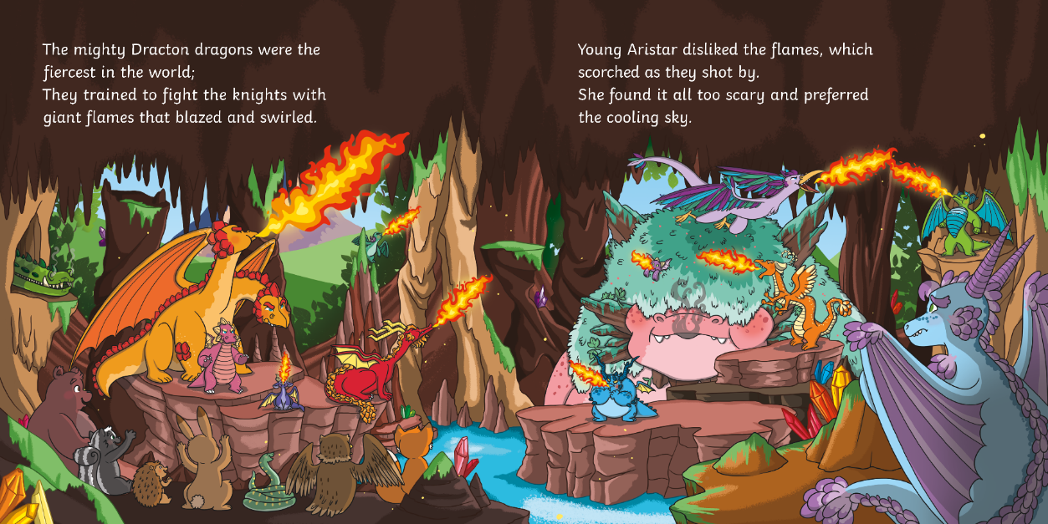
?
Which dragon do you think is Aristar?
Why do you think that?

Slide 7
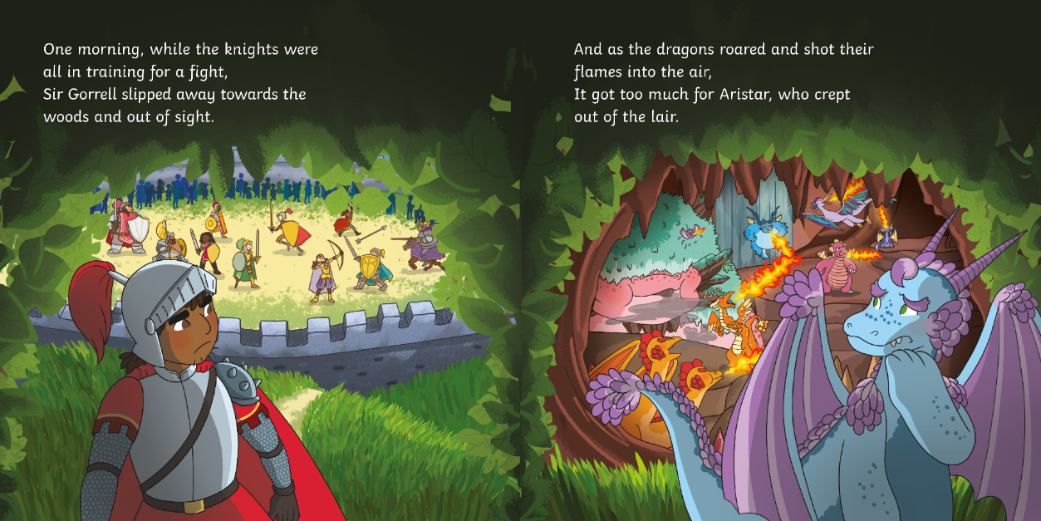
?
Why are Sir Gorrell and Aristar sneaking away?

Slide 8
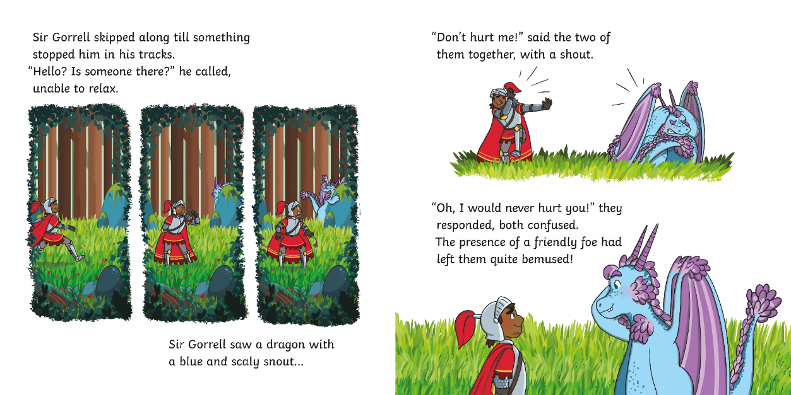
?
Which words describe the dragon?

Slide 9
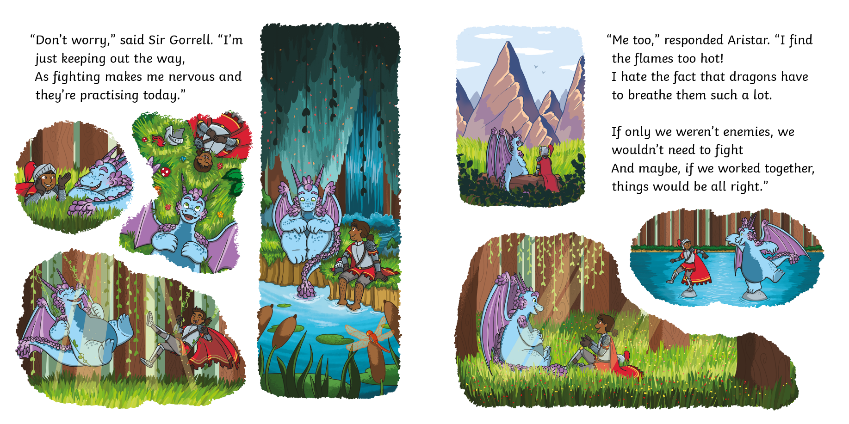
?
What do you think an enemy is?

Slide 10
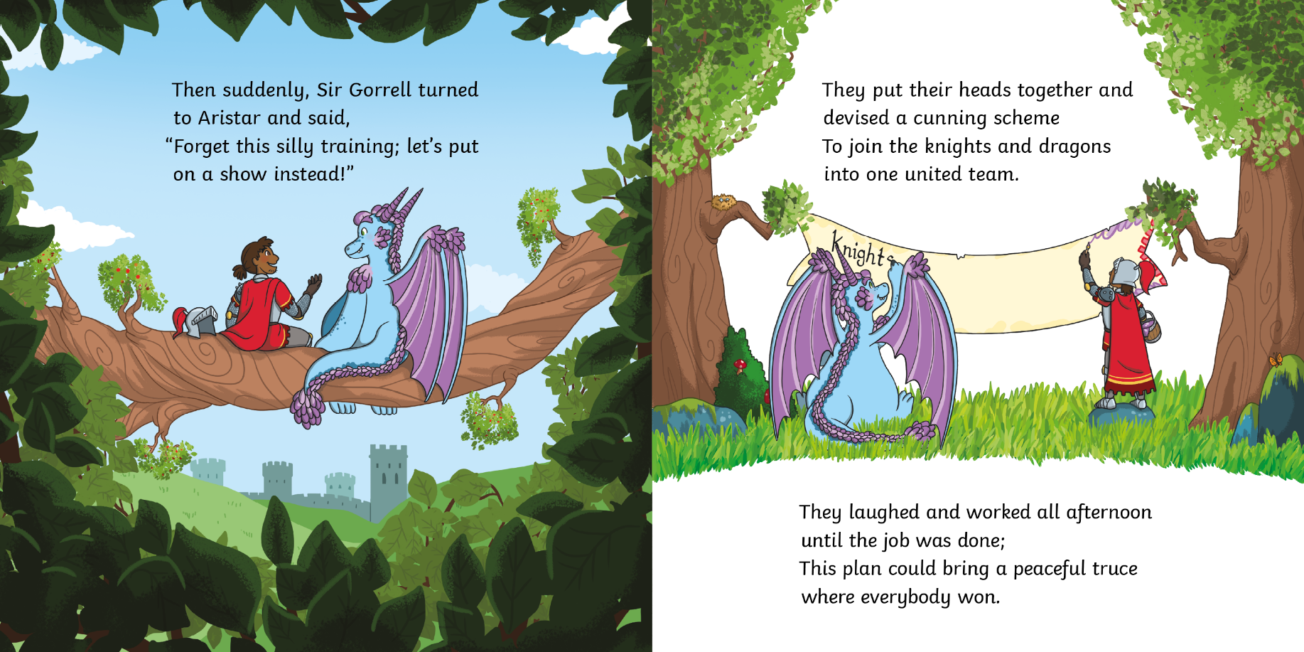
?
What kind of show do you think Sir Gorrell and Aristar are planning?

Slide 11
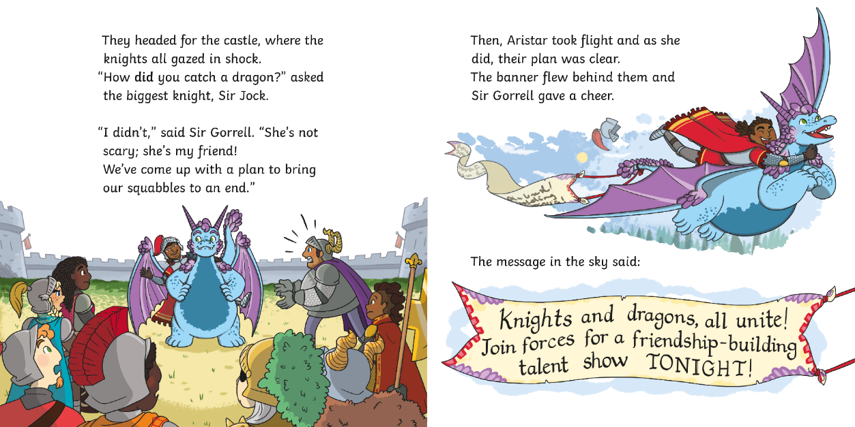
?
Why do the knights think Sir Gorrell ‘caught’ Aristar?

Slide 12
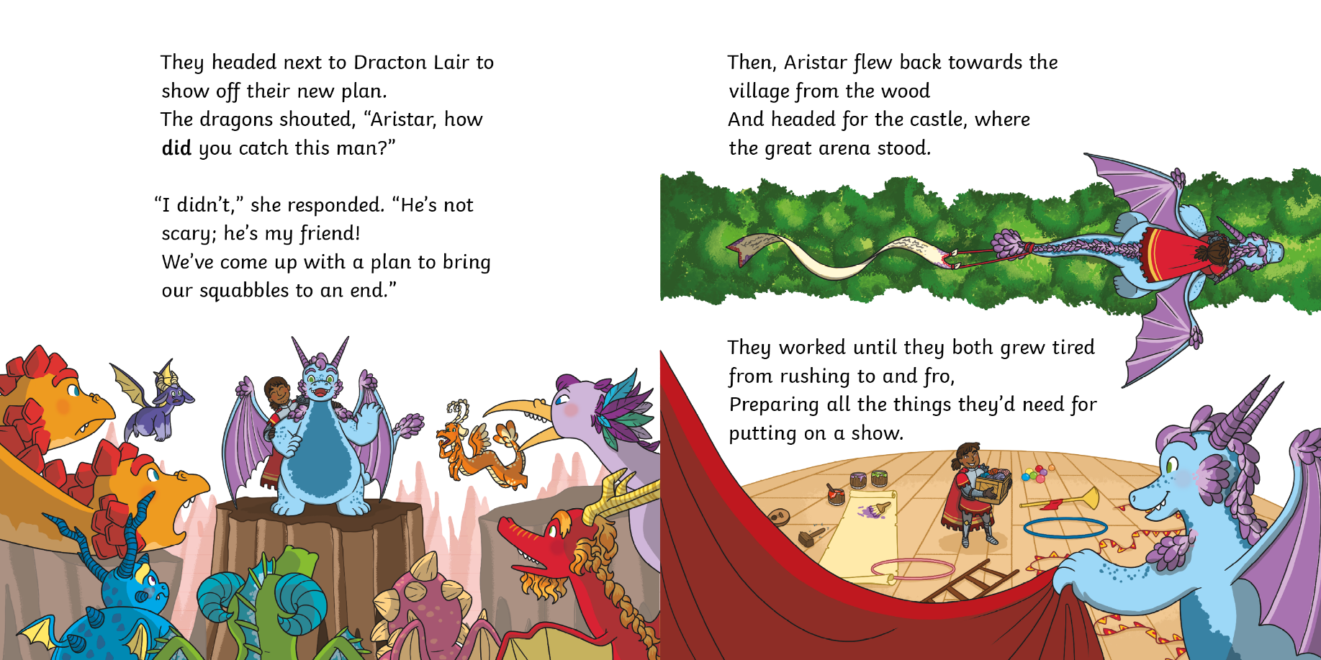
?
How does Aristar describe Sir Gorrell?

Slide 13
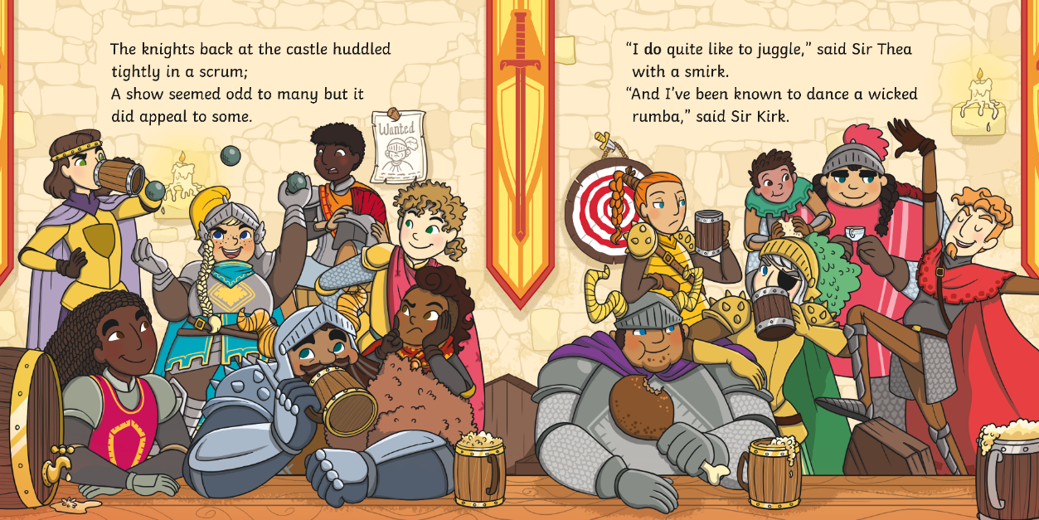
?
Which character likes to juggle?

Slide 14
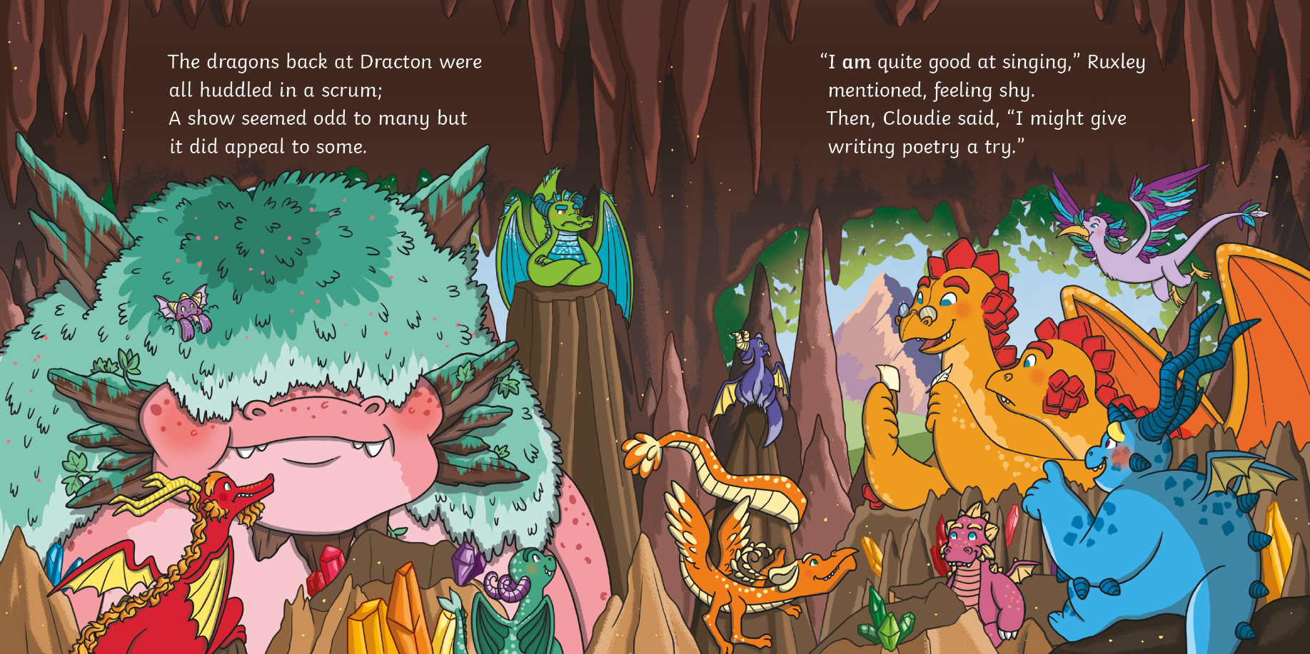
?
Why do you think a show seems odd to some of the dragons?

Slide 15
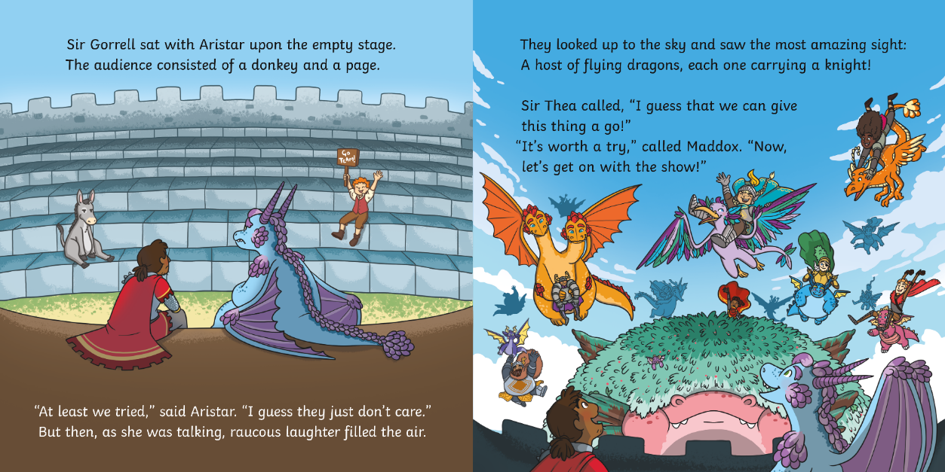
?
What is the ‘most amazing sight’ Sir Gorrell and Aristar see?

Slide 16
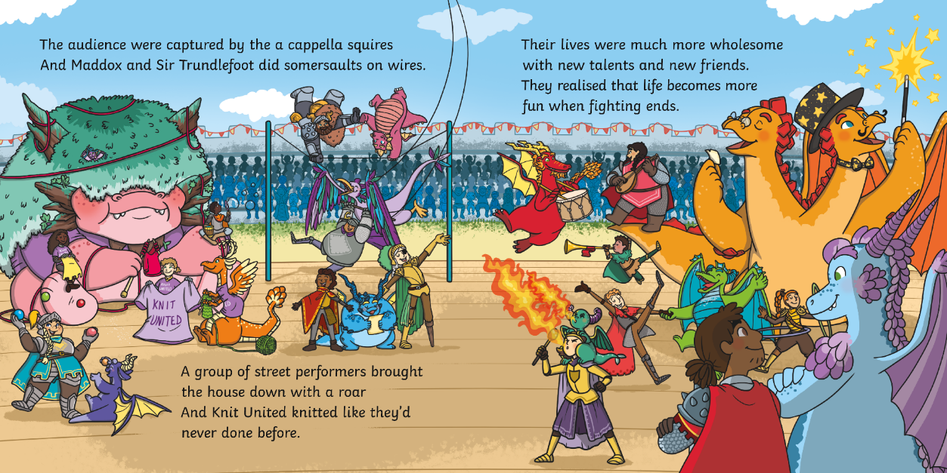
?
How do you think Aristar and Sir Gorrell are feeling at the end of the story? Why?

Slide 17
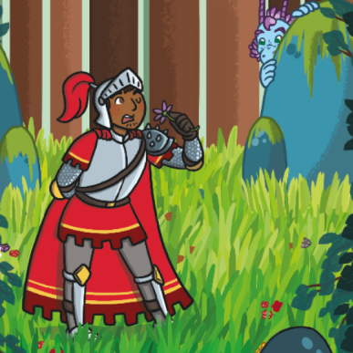
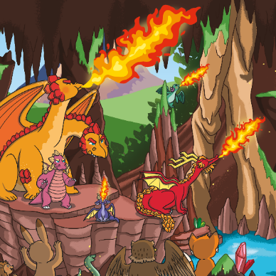
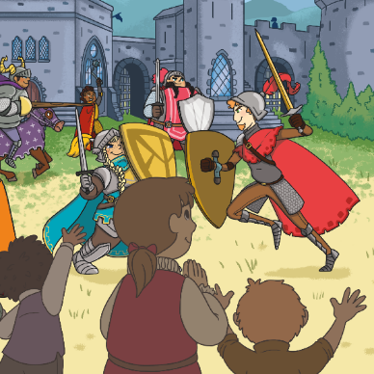
?
What does Sir Gorrell find scary?
the woods
fire
swords and angry steeds

Slide 18
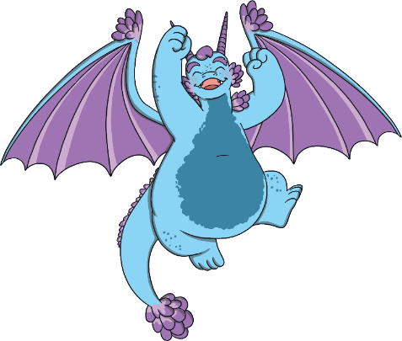
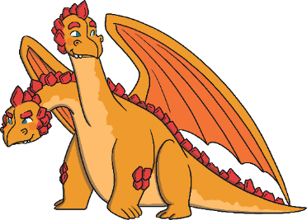
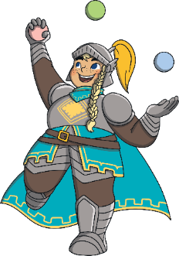
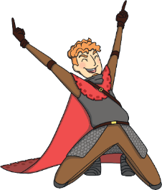
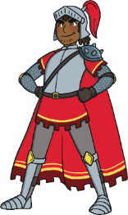
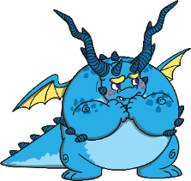
?
Who are the main characters in this story?
Ruxley and
Sir Kirk
Aristar and
Sir Gorrell
Cloudie and
Sir Thea

Slide 19
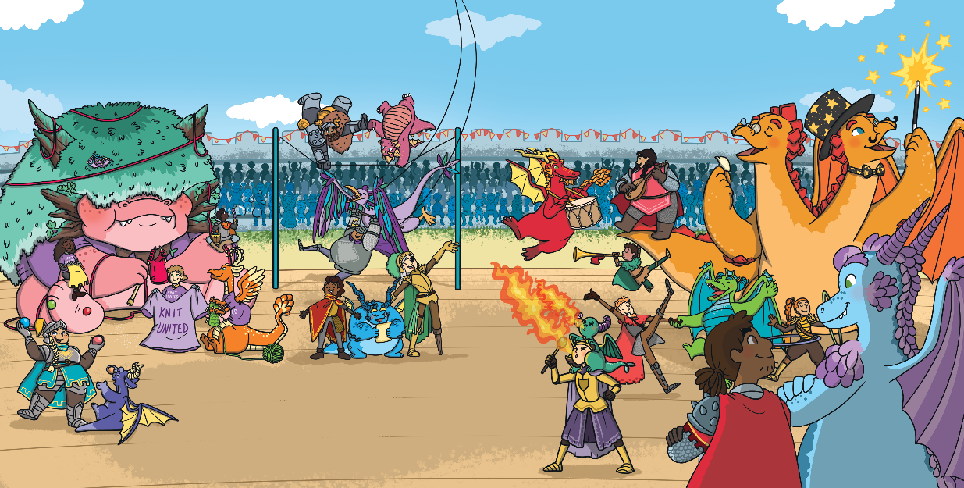
?
Do you think there is a message in this story?
What do you think it might be?

Slide 20
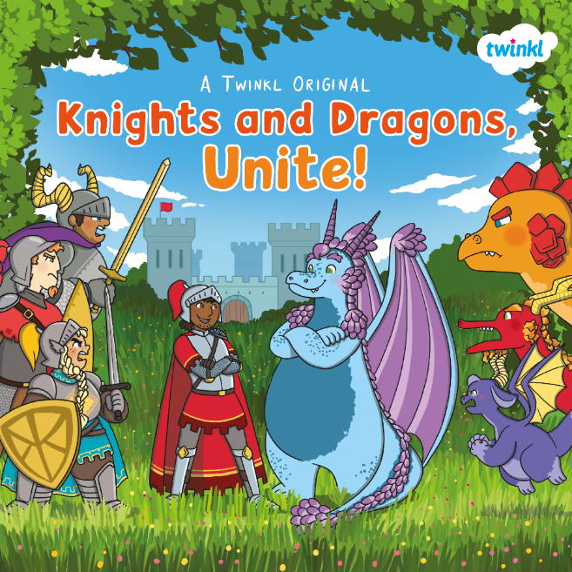
?
What is your favourite part of the story?
Why?

