Slide 1
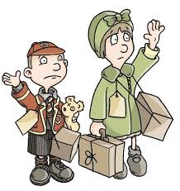
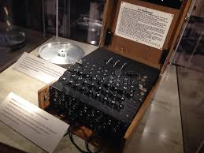
English
Our main text will be Goodnight, Mr Tom as well as many non-fiction texts and articles. We will be reading, writing and discussing a variety of genres including diaries, letters, biographies, narratives and poetry. Feeding into this, we will be thinking about how best to express our ideas with relevant vocabulary, sentence structure and punctuation.
History & Geography
We will focus our WWII studies on life on the home front and the Battle of Britain, considering causation and significance of events and the nature and reliability of evidence. As geographers, we shall further our knowledge of the countries and cities of the world and Europe and Poland in particular.
Science
In science we will be exploring our Solar System – and beyond! We will learn about planets and stars and how and why we have night, day, seasons and shadows as well as learning about the incredible achievement of putting man on the moon.
French
The children will be developing their aural, spoken and written communication about themselves, the calendar, the weather and the planets.
Over & Above!
2019 is not only 80 years since the outbreak of WWII, it is also 50 years since Man stood on the Moon -
two life changing events in which humankind demonstrated incredible resilience, endured adversity and changed the world.
Year 6 Autumn 2019
Maths
The children will be consolidating their understanding of place value (the value of each digit in a number), extending their understanding of methods of calculation and developing their geometry skills by plotting and moving coordinates and shapes on grids.
Computing
Cracking the enigma code was an integral part of ending the war in 1945. The children will learn about Bletchley park and the important work done by Alan Turing and the other code breakers. They will also be creating and cracking their own codes.
Art & DT
Inspired by iconic images associated with the Moon landing, we will be thinking about how we can leave our own marks, developing different techniques to convey shadow with pencils and using watercolours.
We will also be rationing ourselves while baking and learning to ‘make do and mend’ to create a soft toy.
RE / SMSC
The children will be responding to the question ‘Why do some people believe in God?’ and learning from different religious and non-religious groups about their beliefs. We will also consider cooperation between countries and the United Nations Universal Declaration of Human Rights.
Music
We will be listening to and learning ‘Wartime’ songs as well as learning how to play instruments.
PE
Skills will be learned using the ‘REAL’ PE scheme as well as playing team games in which we will discuss the importance of sportsmanship and teamwork.

