Slide 1
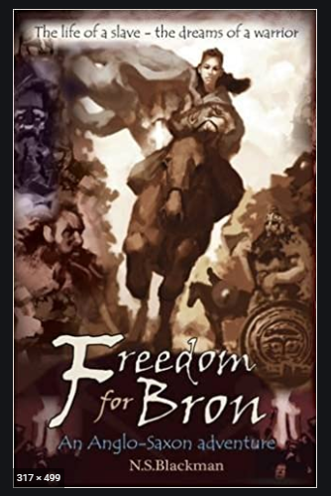
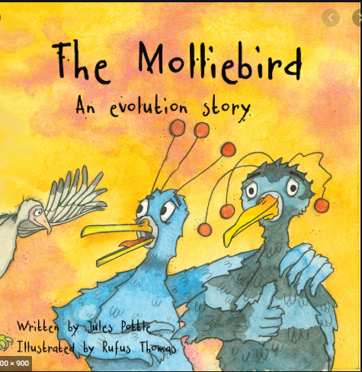
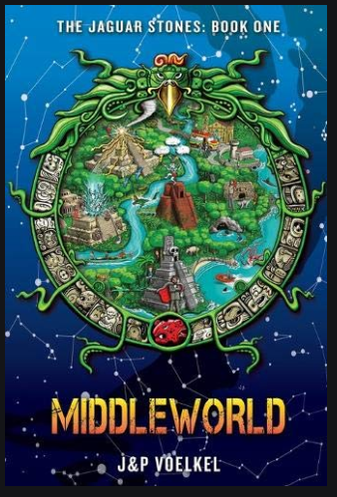
Spring 2021
The Vikings
Summer 2021
Survival
Autumn 2020
Anglo Saxons
Non Fiction Survival Stories
Historical Fiction
Plot: Adventure
Poetry about Evolution
Historical Fiction
Plot: Adventure
Modern Fiction
Plot: Fantasy
Fiction
Plot: Survival
Spring 2022
Ancient Greeks
Space / the universe
Historical Fiction
Plot: Adventure
Modern Fiction
Plot: Survival
Summer 2021 Maya Civilisation
Autumn 2021
Above & Beyond
Historical Fiction
Plot: Adventure
Einstein Book Journey
Autobiography

