Slide 2
The Letter X Looks Like This…
X
x
Click on the pencil to see the letter formation.
Can you draw it with your finger?

Slide 3
The Letter X Sounds like This…
X, X, X
Notes:
Teaching note: Say the sound /x/ and have children repeat it back multiple times.

Slide 4
It Can Also Look like This…

Slide 5
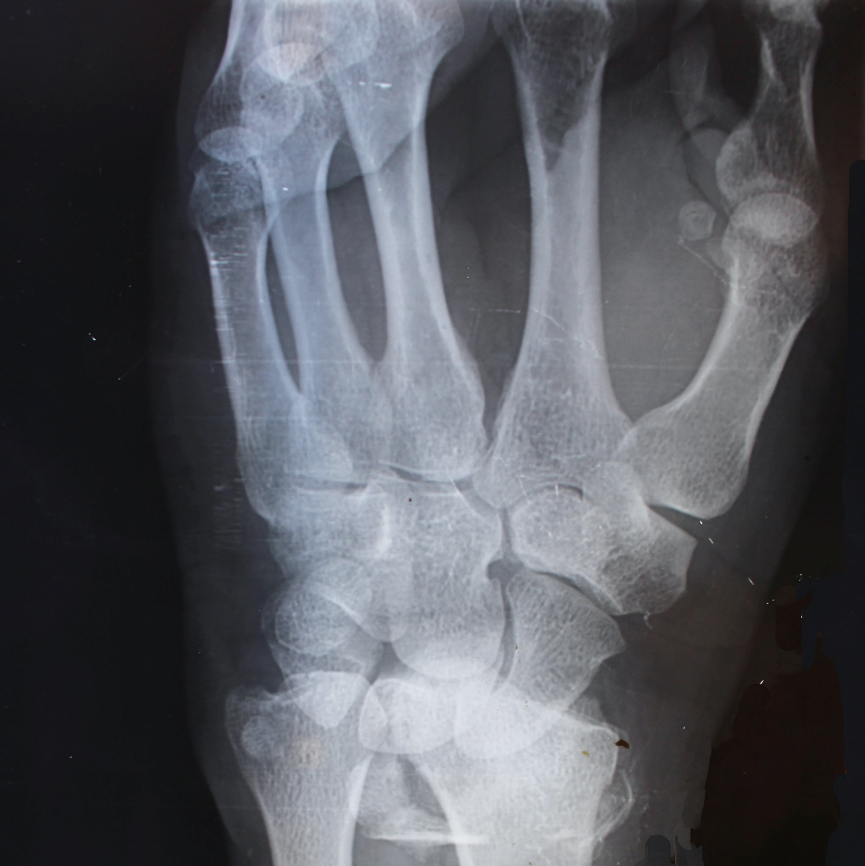
Some Things That Contain X Are…

Slide 6
Which of These Contains X?
TRY AGAIN!
YES!
6
Notes:
Teaching note: Pause briefly after the initial sound of each word to assist students to identify the sounds.

Slide 7
Which of These Contains X?
TRY AGAIN!
YES!
Notes:
Teaching note: Pause briefly after the initial sound of each word to assist students to identify the sounds.

Slide 8
Which of These Contains X?
TRY AGAIN!
YES!
Notes:
Teaching note: Pause briefly after the initial sound of each word to assist students to identify the sounds.

Slide 9
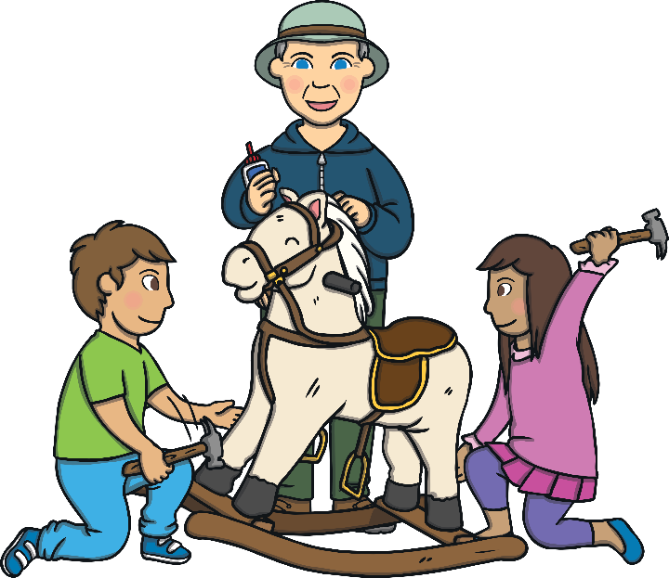
Which of These Contains X?
TRY AGAIN!
YES!
Notes:
Teaching note: Pause briefly after the initial sound of each word to assist students to identify the sounds.

