Slide 1
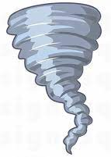
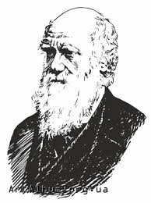
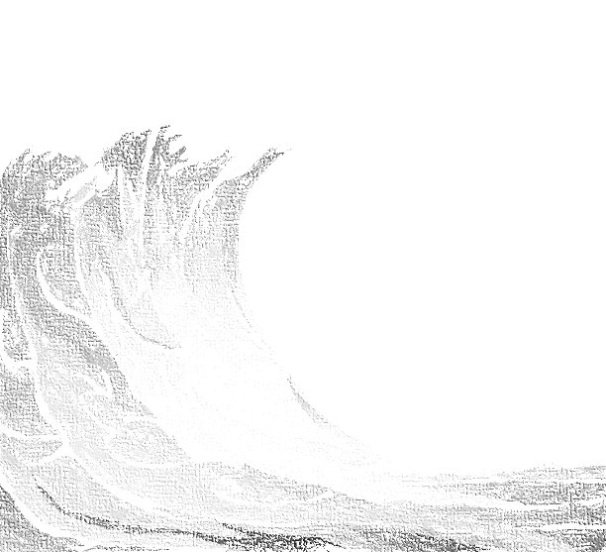
English
We shall be developing a secure understanding of the grammar needed when writing flashback stories and instructions and explanation texts this term, such as: use of formal and informal speech and structure; modal verbs; relative clauses; cohesion; the use of semi-colon/dash between independent clauses; and layout devices. Throughout, we shall have a strong focus on spellings, punctuation, vocabulary and handwriting.
We shall be reading Kensuke’s Kingdom by Michael Morpurgo.
History & Geography
As our overarching topic this term is Natural Disasters, we shall be exploring a range of disaster which have occurred around the world throughout history, as well as exploring: the structure of the Earth; the processes which take place when there is an earthquake, tsunami, tornado and a volcanic eruption; and the global impact of these extreme events.
Science
Darwin’s ‘Survival of the Fittest’ theory, inheritance and adaptation will be studied in our Evolution topic. The children will work scientifically by looking for patterns, sorting and classifying as well as completing an experiment about the ‘Darwin Finches’.
Spanish
We will be focusing on reading, writing and spoken language with the support of singing.
Natural Disasters
Year 5/6 Summer 2021
Music
This term, we shall be exploring music from different cultures and learning about a range of composers and musicians.
Maths
The children will learn about the relationship between decimals, fractions and percentages. They will continue to develop their number sense and fluency as well as investigate angles and 3D shapes, including how to create nets.
Computing
E-Safety will focus on Privacy and Security plus online health and wellbeing. The children will also be learning how to create animations in Scratch and code simple quizzes and games
RE / SMSC
This term we shall be endeavouring to answer the question: What difference does it make to believe in Ahimsa (harmlessness), Grace & Ummah (community)?
We shall consider: what these 3 concepts mean to religious people; connections between beliefs of different faiths; and challenges that religions face in Britain.
RSE/PSHE
Throughout PSHE, we shall be exploring Healthy Living, with a focus on eating and substances which damage our health. In RSE, we will be learning about risks and responsibilities as well as the mental and physical impacts they may have on us.
Art & DT
The children will be exploring the use of colour through the theme: Natural Disasters. We shall explore a range of materials and the different uses of colour to develop effective art work and DT projects depicting these disastrous events.
PE
Children will be focusing on rounders and athletics this term, developing physical, social and cognitive skills along the way.

